Slide 1
CS250 Computer Architecture Lab 01 – Introduction and Lab Safety
Semester Week 01
Spring 2018
Purdue University
© 2017 by George B. Adams III

Slide 2
EMERGENCY PREPAREDNESS (part 1)
To report an emergency, call 911. To obtain updates regarding an ongoing emergency, sign up for Purdue Alert text messages, view www.purdue.edu/ea.
There are nearly 300 Emergency Telephones outdoors across campus and in parking garages that connect directly to the PUPD. If you feel threatened or need help, push the button and you will be connected immediately.
© 2017 by George B. Adams III
Notes:
One final piece of Purdue business before we begin: as we start this semester I want to take a few minutes to discuss emergency preparedness. Purdue University is a very safe campus and there is a low probability that a serious incident will occur here. However, just as we receive a safety briefing each time we get on an aircraft, we want to emphasize our emergency procedures for evacuation and shelter in place incidents. Our preparedness will be critical if an unexpected event occurs.
Purdue prepares for natural disasters or human‑caused incidents with the ultimate goal of maintaining a safe and secure campus, but in the end, emergency preparedness is your personal responsibility. Let’s quickly review the following procedures:

Slide 3
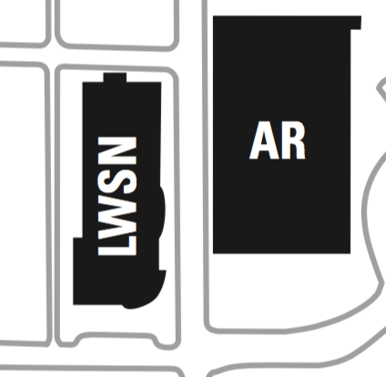
EMERGENCY PREPAREDNESS (part 2)
Fire (loud buzzing alarm and flashing lights)
Evacuate immediately via stairwell
Do not use the elevator
Meet outside LWSN, as indicated by the
© 2017 by George B. Adams III
Notes:
One final piece of Purdue business before we begin: as we start this semester I want to take a few minutes to discuss emergency preparedness. Purdue University is a very safe campus and there is a low probability that a serious incident will occur here. However, just as we receive a safety briefing each time we get on an aircraft, we want to emphasize our emergency procedures for evacuation and shelter in place incidents. Our preparedness will be critical if an unexpected event occurs.
Purdue prepares for natural disasters or human‑caused incidents with the ultimate goal of maintaining a safe and secure campus, but in the end, emergency preparedness is your personal responsibility. Let’s quickly review the following procedures:

Slide 4
EMERGENCY PREPAREDNESS (part 3)
If we are notified during class of a Shelter in Place requirement for a tornado warning, we will suspend class and shelter in [the basement].
If we are notified during class of a Shelter in Place requirement for a hazardous materials release, or a civil disturbance, including a shooting or other use of weapons, we will suspend class and shelter in the classroom, shutting the door and turning off the lights.
Please review the Emergency Preparedness website for additional information. http://www.purdue.edu/ehps/emergency_preparedness/index.html
© 2017 by George B. Adams III
Notes:
One final piece of Purdue business before we begin: as we start this semester I want to take a few minutes to discuss emergency preparedness. Purdue University is a very safe campus and there is a low probability that a serious incident will occur here. However, just as we receive a safety briefing each time we get on an aircraft, we want to emphasize our emergency procedures for evacuation and shelter in place incidents. Our preparedness will be critical if an unexpected event occurs.
Purdue prepares for natural disasters or human‑caused incidents with the ultimate goal of maintaining a safe and secure campus, but in the end, emergency preparedness is your personal responsibility. Let’s quickly review the following procedures:

Slide 5
Lab 01 – Introduction and Safety
© 2017 by George B. Adams III

Slide 6
Welcome to CS250 lab
GTA Lab Instructor: <your name>
Email: <your email>
Personal history
BS ,your alma mater>, etc.
focused on <your tecnhical area>
<perhaps worked at somewhere>
I enjoy
<this or that, something humanizing about you>

Slide 7
What to expect of your instructors
The UTAs and I welcome you to CS 250
Our task is to support you in your effort to succeed in this course, especially the lab
We welcome your questions: in lab, on Piazza, via email
We ask for your feedback throughout the semester
© 2017 by George B. Adams III
Notes:
Each of you belong here; the TAs and I are happy you are here.
This will be a demanding and reasonable course. I know that each of you can succeed in this course.
Be in touch with us throughout the semester.
What is working, what has failed, what could be better.

Slide 8
What we expect of students
Attendance and being engaged
Integrity and honesty
© 2017 by George B. Adams III
Notes:
This will be a demanding and yet reasonable course. Do your work with integrity and honesty.
I will not take attendance in lecture, but not attending tends to undermine my support for your success.
That said, I understand the necessity of occasional absence. Let me know; I’m happy to arrange support for arranged absences.

Slide 9
Lab 01 – Agenda
Become familiar with B160 lab room equipment and safety procedures
Complete the lab safety quiz
Receive and sign for your lab kit
Accomplish the tasks in Lab 01
© 2017 by George B. Adams III

Slide 10
Why are we here?
People who are really serious about software should make their own hardware.
Alan Kay
Recipient of the 2003 ACM Turing Award "For pioneering many of the ideas at the root of contemporary object-oriented programming languages, leading the team that developed Smalltalk, and for fundamental contributions to personal computing."
© 2017 by George B. Adams III

Slide 11
Electrical circuit elements
Electrical energy sources (measured with voltage and current)
Devices to transport, modify, transform, and control electrical energy
Using your lab kits, you will work with
1 USB port [convenient source of 5V electrical energy]
about 10 feet of wire and 5 switches [transport]
20 Resistors [modify: dissipate energy]
2 Capacitors [modify: store and release charge]
9 Light-emitting diodes (LEDs) [transform: to photons]
and, literally, billions of transistors
[control: switch on and off the paths to pools of
electrons of different voltage energy levels]
© 2017 by George B. Adams III
Notes:
Transistors are the brains of the outfit

Slide 12
What does the lab kit enable?
Hardware (HW)
Exploration of Boolean logic circuits
What is our computing platform built from?
How does this technology behave?
What can we ask and not ask of it?
Software (SW)
Programming the “bare metal” of a computer
What does the meeting of software with hardware look like?
What are the considerations?
© 2017 by George B. Adams III

Slide 13
BOM – bill of materials
Bill of materials (BOM) – a list of the raw materials, sub-assemblies, and/or parts and the quantities of each needed to manufacture an end product
The following slides provide a visual BOM of the contents of your lab kit

Slide 14
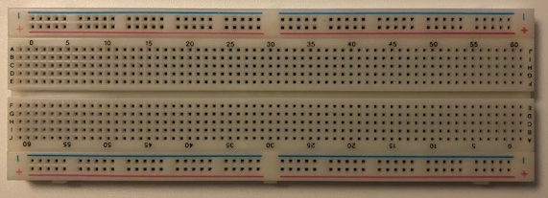
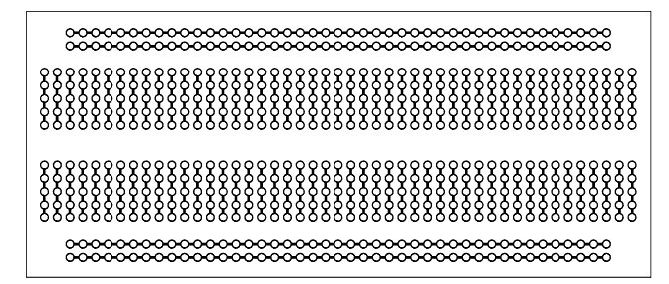
Breadboard – platform for circuit building
Devices and wires plug into the breadboard
Connections between the tie points (see textbook page 446 for more information)

Slide 15
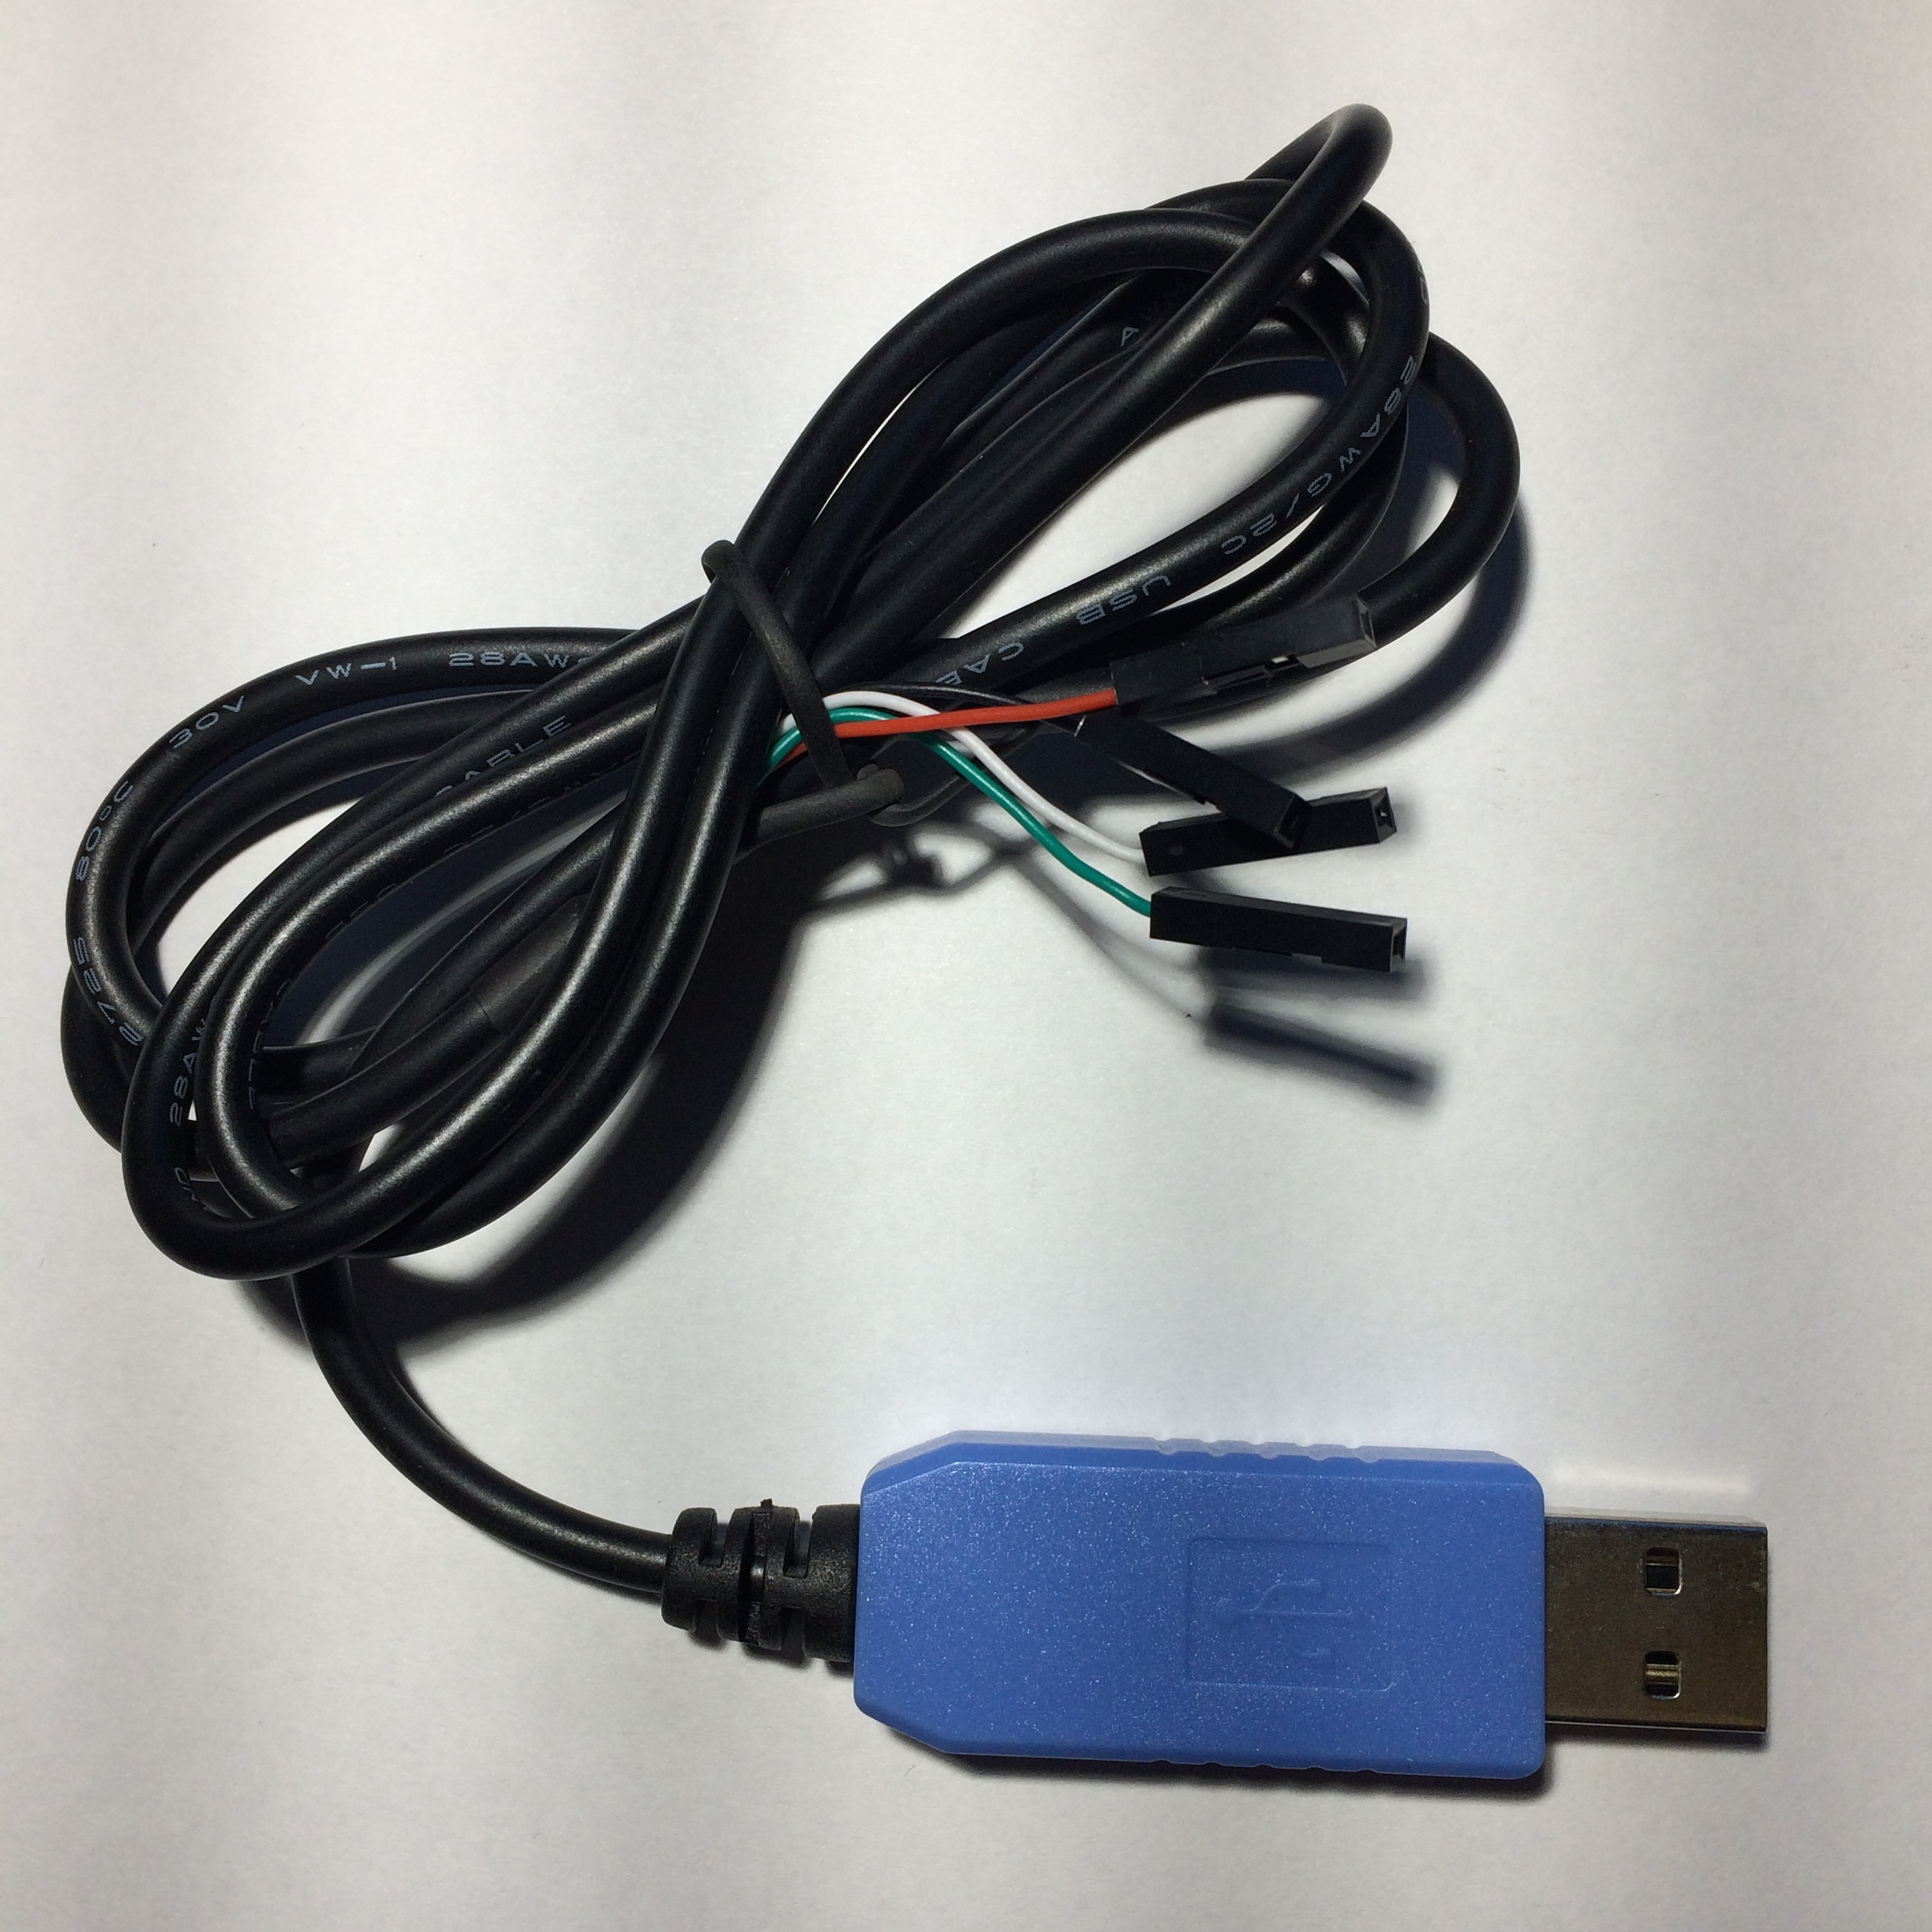
USB console cable for breadboard power
Breaks out the 4 wires of a USB cable by function
White & green wires together deliver 1 data bit
Red & black are +5 volts and ground, respectively
Used to deliver 5 volts and up to 0.5 amps to circuits on the breadboard
© 2017 by George B. Adams III
Notes:
You will get 1 of these

Slide 16
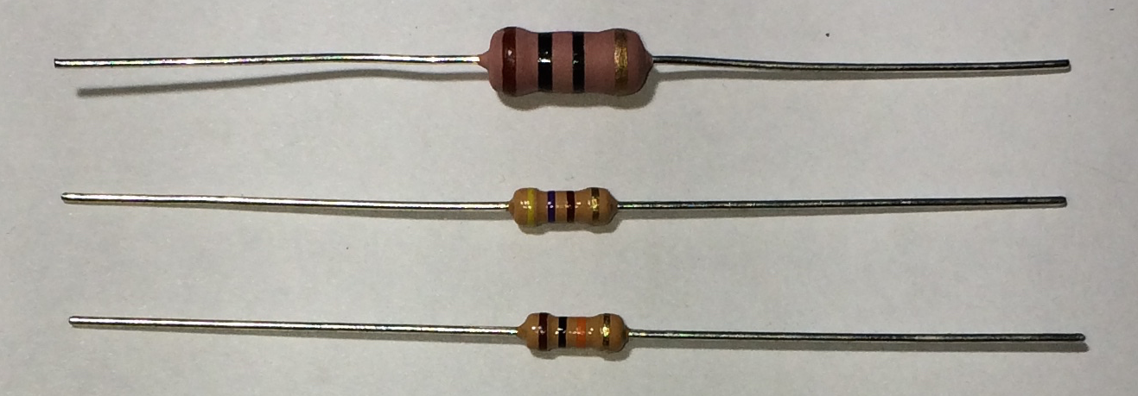
Resistors 10 Ω (ohms), 470 Ω, and 10 KΩ
Three color bands encode resistance, fourth encodes value tolerance; size encodes heat dissipation ability
(Quantity 1) Brown, Black, Black, Gold means 10x10⁰ ±5% = 10 ± 0.5 Ω and size permits heat dissipation of up to 2 Watts
(Quantity 10) Yellow, Purple, Brown, Gold = 47x10¹ ±5% = 470 ± 23.5 Ω and smaller size permits heat dissipation of up to ¼ Watt
(Quant. 10) Brown, Black, Orange, Gold = 10x10³ ±5% = 10,000 ± 500 Ω
Used to change voltage
© 2017 by George B. Adams III
Notes:
Color bands encode for two significant digits, an exponent of 10, and a percentage tolerance.

Slide 17
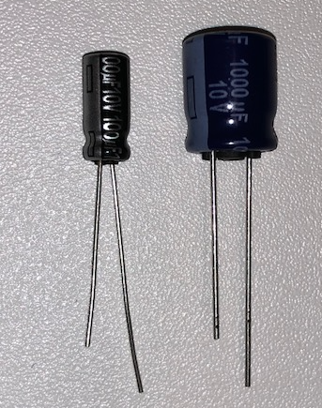
Capacitors: 100μF (micro-Farads) and 1000μF
Stores energy in the form of an electric field
Voltage between the two leads (wires sticking out) increases with increased stored energy
© 2017 by George B. Adams III

Slide 18
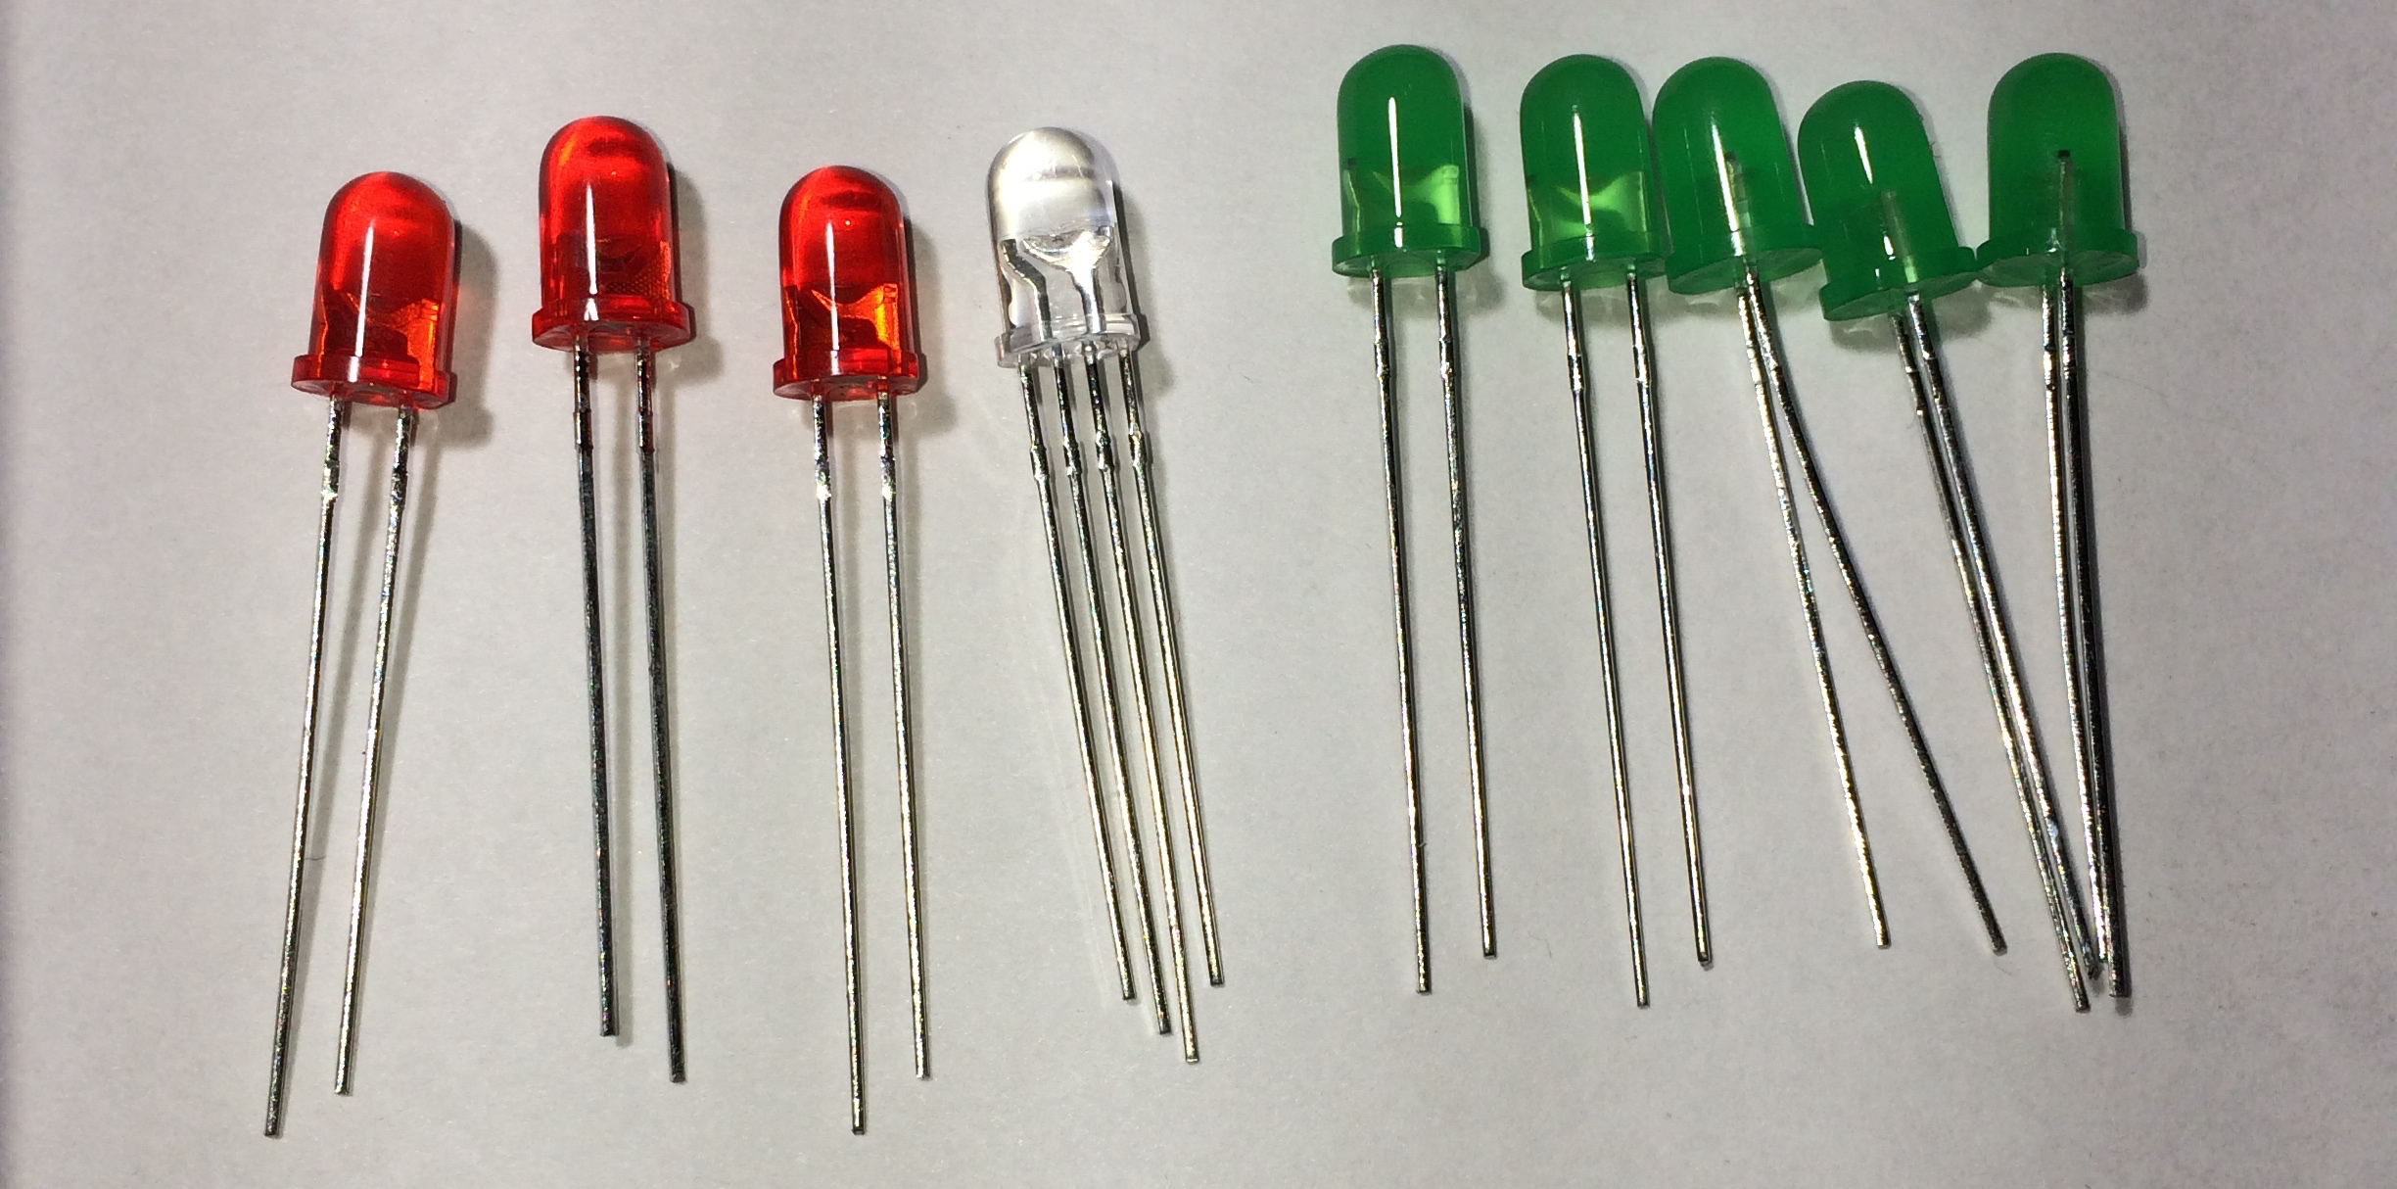
Light-emitting diodes (LEDs)
Red, clear is 3-in-1 tri-color (RGB), and green
Used to output computational results and for printf( )-style debugging of hardware circuit
© 2017 by George B. Adams III

Slide 19
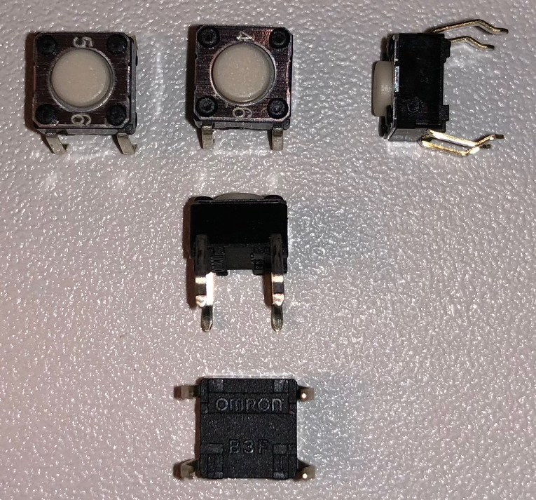
Switch of type haptic pushbutton, SPST-NO
Haptic pushbutton = switch gives operational feedback via the sense of touch when the button is pushed
SPST-NO = single pole /single throw topological electrical contact configuration that is “normally” open
normal = button not being pushed
open = no electrical connection between switch terminals
Used in conjunction with a resistor to input one bit of data to a logic circuit
© 2017 by George B. Adams III

Slide 20
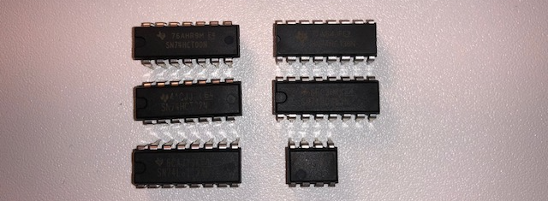
Integrated circuits (ICs)
Contain logic gates and basic building block circuits for digital computers
2 more SN74HTC00N chips are on backorder; they will be distributed in a lab to follow
© 2017 by George B. Adams III

Slide 21
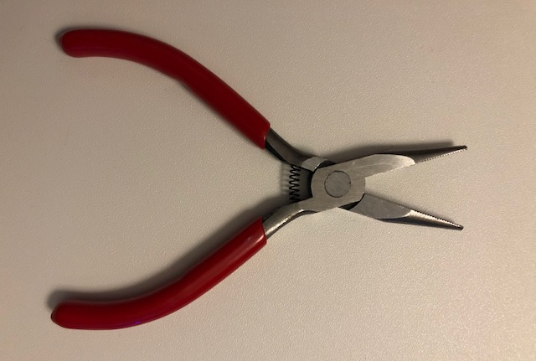
Needle nose pliers
Used as a supplement to / in addition to fingers to insert/remove items from the breadboard
Used to straighten bent IC pins
© 2017 by George B. Adams III

Slide 22
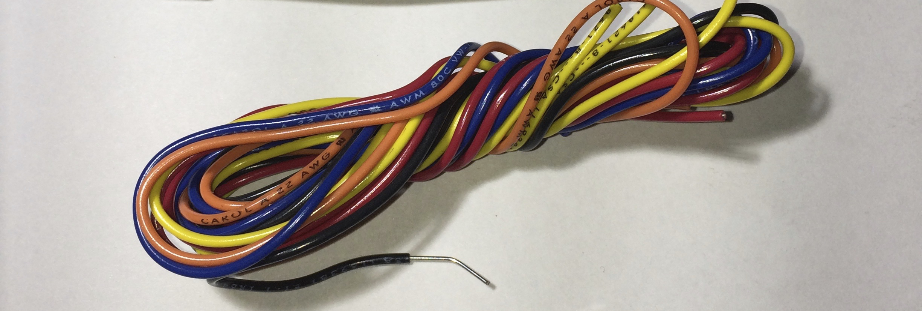
Hookup wire (available in lab when needed)
Copper wire with colorful plastic insulation
Used to connect devices on the breadboard (not part of your lab kit)
Available in lab at self-serve station in the back
© 2017 by George B. Adams III

Slide 23
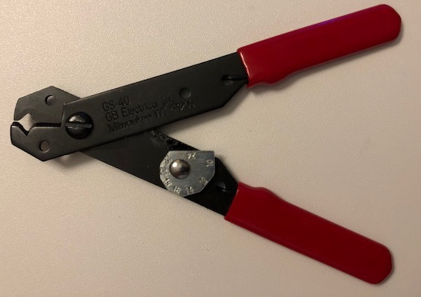
Wire cutter and stripper
Used to cut hookup wire and to remove plastic insulation from hookup wire ends
© 2017 by George B. Adams III

Slide 24
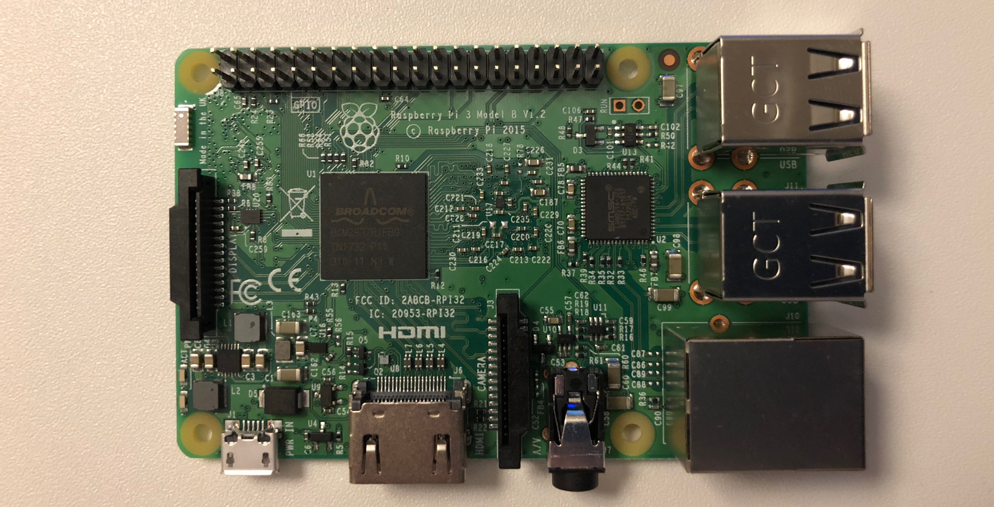
Raspberry Pi 3 Model B V1.2 computer
Single-board computer
© 2017 by George B. Adams III

Slide 25
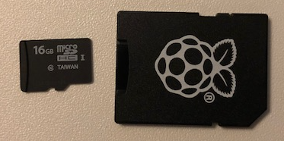
microSD card and SD form factor adaptor
microSD card (left item in photo) stores Raspbian O/S for Pi and the user file system
SD physical format adaptor allows easy use of microSD card with original SD-size ports
© 2017 by George B. Adams III

Slide 26
Physical handling of the Raspberry Pi
Treat your Pi gently and it will work indefinitely long, however, excessive force can render your Pi inoperative, e.g.,
Pushing hard on an inserted microSD card can break the connection from the card to the Pi
Bending the Pi can crack wires within its circuit board, breaking needed connections
The Pi has many uninsulated exposed points on its circuit board, prevent them from touching metal
Do not place your Pi on a metal surface, causing addition of a perhaps damaging electrical connection among the Pi components
Do not allow small metal parts, hookup wire clippings, and the like to fall onto your Pi

Slide 27
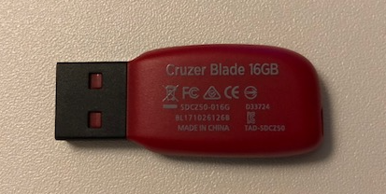
Flash drive for backup of Pi microSD card
Use this flash drive to make regular backup of all the software on the microSD card of your Raspberry Pi computer
© 2017 by George B. Adams III

Slide 28
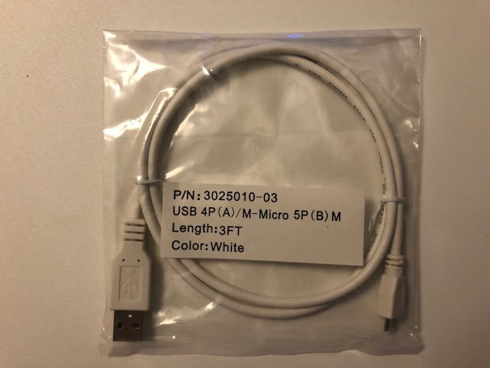
USB to micro USB cable 5 volt power
Used to power the Raspberry Pi from a standard USB port
© 2017 by George B. Adams III

Slide 29
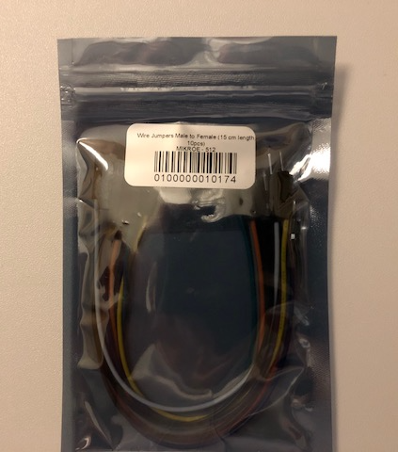
Jumpers – to connect Pi with breadboard
© 2017 by George B. Adams III

Slide 30
Lab Safety – burns
Lab circuits use low voltage (5 volts), so there is no electrical shock hazard, however
Miss-connected circuit elements can become hot enough to cause a burn to bare skin
If a circuit part is hot to the touch, then there is an error in circuit wiring
Remove power to the circuit
Debug until the error is found and corrected
If you have increased or decreased skin sensitivity to heat, be extra cautious

Slide 31
Lab Safety – mechanical hazards
There are sharp aspects to the pins of electrical devices and your Raspberry Pi, ends of hookup wires, the needle nose pliers, and the wire cutter/stripper
Use care when handling sharp items
Needle nose pliers and wire cutter/stripper present a pinching and/or cutting hazard
Use care when handling these tools

Slide 32
Begin Lab 01 assignment now
Ask questions whenever you need
Login to Blackboard for CS250
Navigate to the Lab 01 folder
Open the Lab 01 Instructions file
Complete Lab 01 before leaving lab

